Slide 1
Automatic Gemstone Classification
Robert Henigan

Slide 2
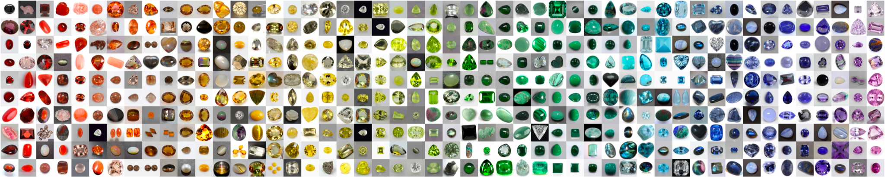
Abstract
Computer Vision Based Image-Based gemstone classification
Viewed 33 different combinations of feature extraction techniques
Used in combination with different machine learning algorithms
Attempted Deep-Learning Classification with ResNet-18 & ResNet-50
Compared Results against Human Experts

Slide 3
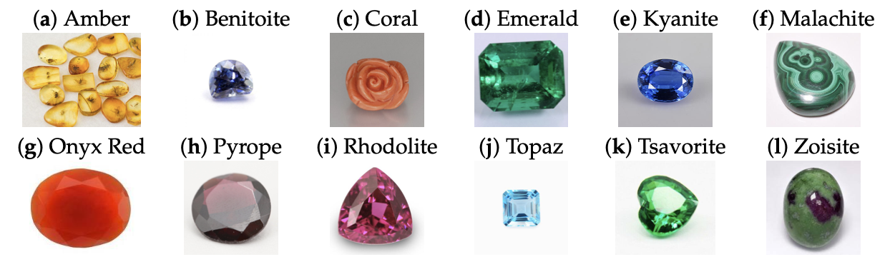
Dataset
2042 Training Images
284 Unseen Test Images
68 Categories
24-44 Training and 4-5 Test Per Class

Slide 4
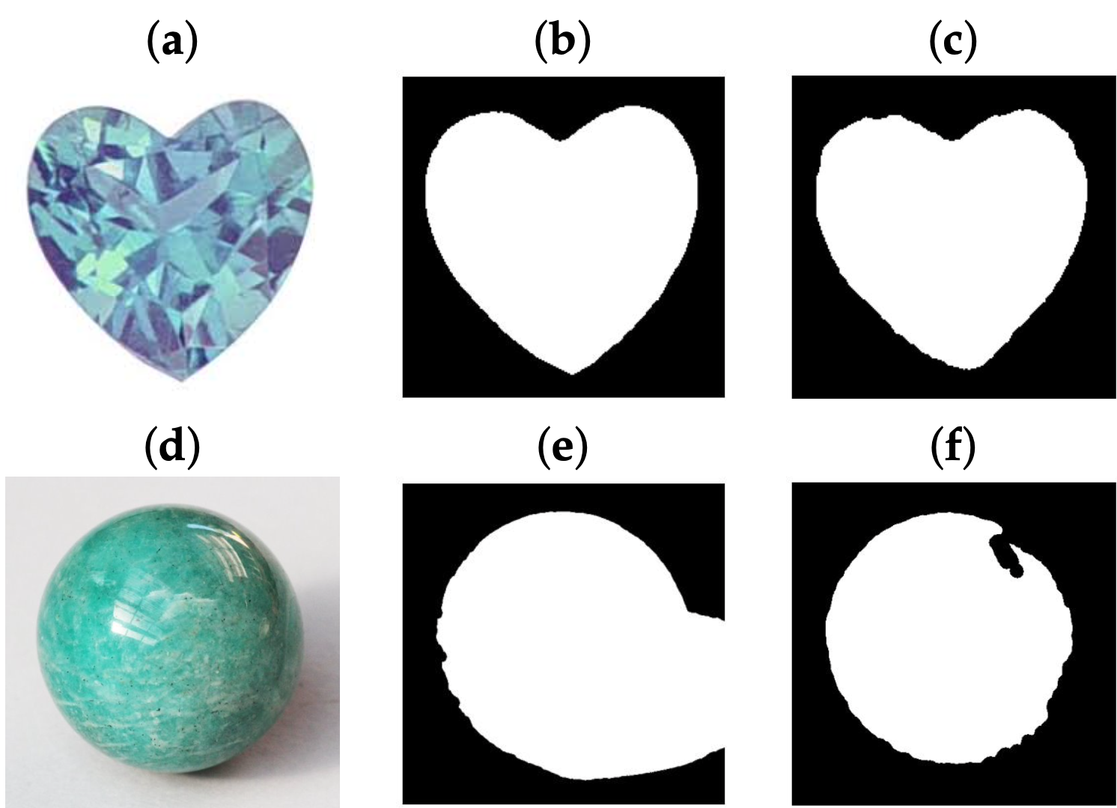
Background Segmentation
Otsu Thresholding to extract Gemstone from the background
Segmentation method that maximizes variance between the background and foreground of the image
Attempted via grayscale or Hue Saturation Value
Whichever result was better per class was selected (background completely removed and most of gemstone was extracted)

Slide 5
Feature Extraction
Low-level Feature Extraction
Edges, colors, textures, shapes, regions, etc.
High-level Feature Extraction
Understanding, Behaviors, Reduction of Dimensionality
33 Features were used based on color and texture from the masked images
Color Feature Extraction was across 3 different color space RGB, HSV, CIELAB
K-means clustering and Color histograms were used to extract color from the gemstones
Textural Feature Extraction using either LBP, Haralick, or GLCM Property

Slide 6
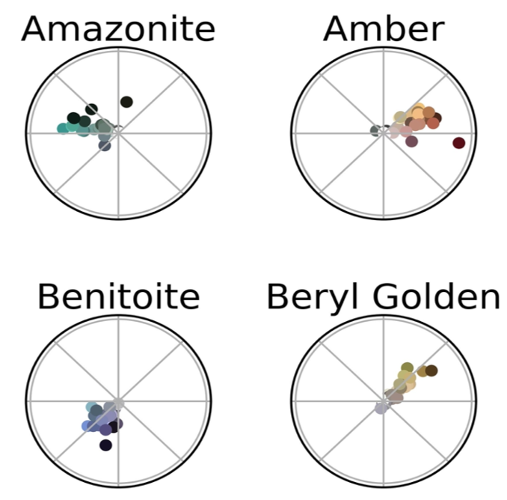
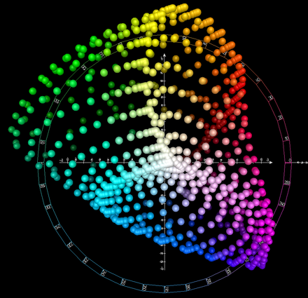
Color Features
RGB (Red - Green - Blue)
4-bin or 8-bin RGB values
HSV (Hue - Saturation - Value)
Represented as a Hexacone
Saturation (Color Intensity) Horizontal Axis
Hue (Color) Circular Angle
Value (Brightness of Color) Vertical Axis
CIELAB (International Commission of Illumination)
L* Lightness
a* and b* 4 unique colors of human vision Red, Green, Blue, and Yellow

Slide 7
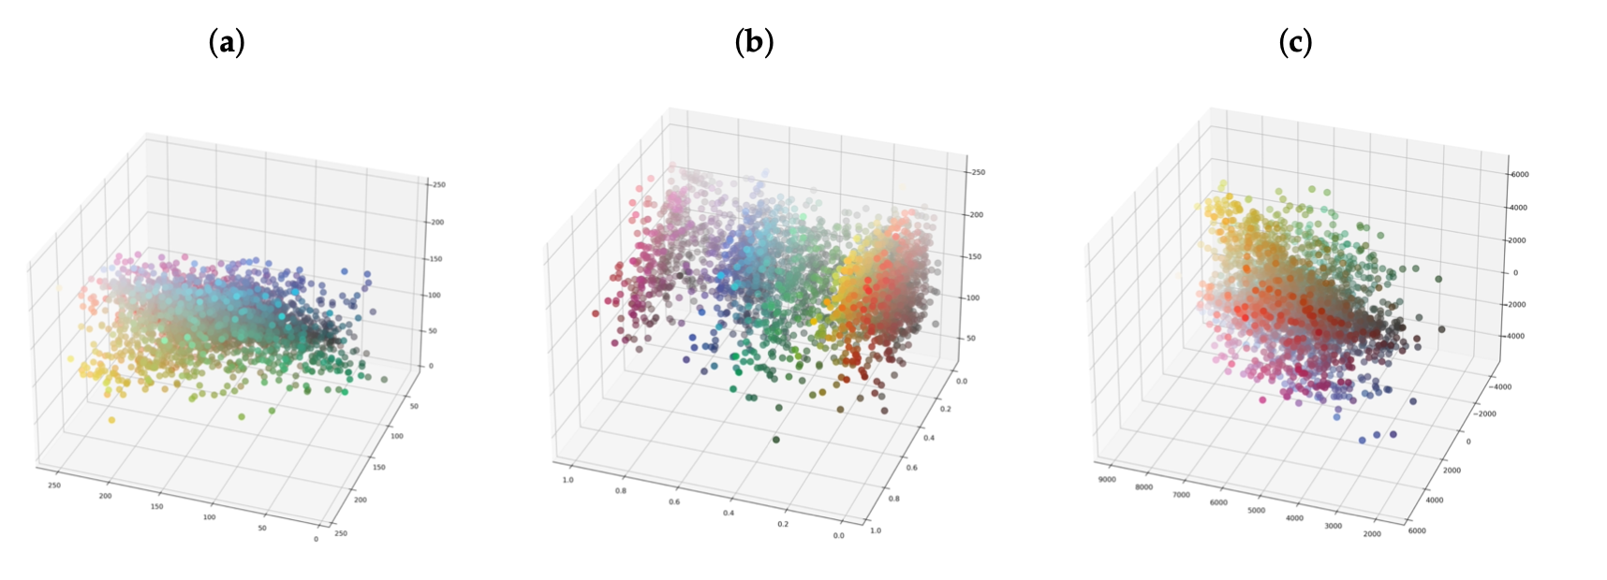
Data Set in Color Spaces
RGB Space
HSV Space
CIELAB Space

Slide 8
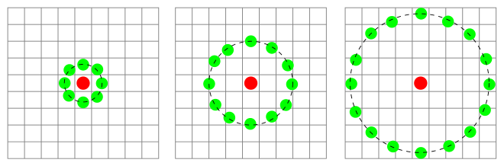
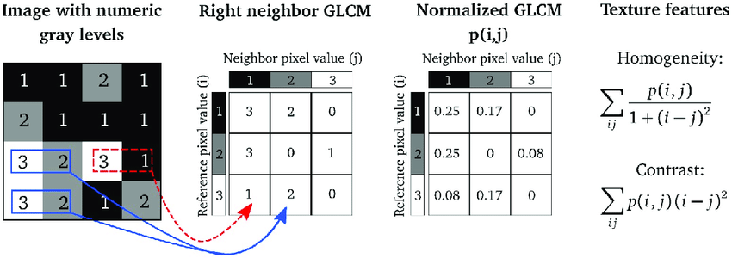
Textural Features
LBP (Local Binary Patterns)
Gray-scale invariant texture-extraction
Binaries Gray scale of neighboring pixels
Either 8, 16, or 24 points at a radius of 1 or 3 were used
Haralick Texture
Describe spatial dependencies of grey levels of neighboring pixels
Derived from 14 Properties (only 6 were used) from the GLCM (Gray Level Co-occurrence Matrix)
Correlation
Energy
Dissimilarity
Homogeneity
Contrast
ASM (Angular Second Moment)

Slide 9
Machine-Learning Algorithms
Logistic Regression
Linear Discriminant Analysis
K-nearest neighbor
Decision Tree
Random Forest
Naive Bayes
Support Vector Machine

Slide 10
Evaluation
Accuracy
(True Negatives + True Positives) / All Predictions
Top-5 Accuracy
Same as accuracy only each machine learning algorithm is given 5 guesses
If any of those guesses are correct the result is counted as a True Positive
Training time
Test Computation Time
Paper: MacBook Pro 2.3 GHz Intel Core i5 processor
Personal: MacBook Pro 2.2 GHz Intel Core i7 processor

Slide 11
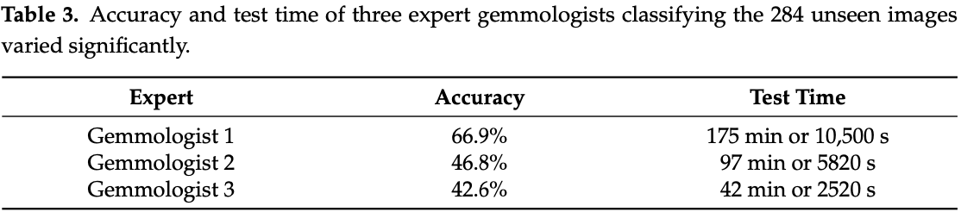
Human Expert Results

Slide 12
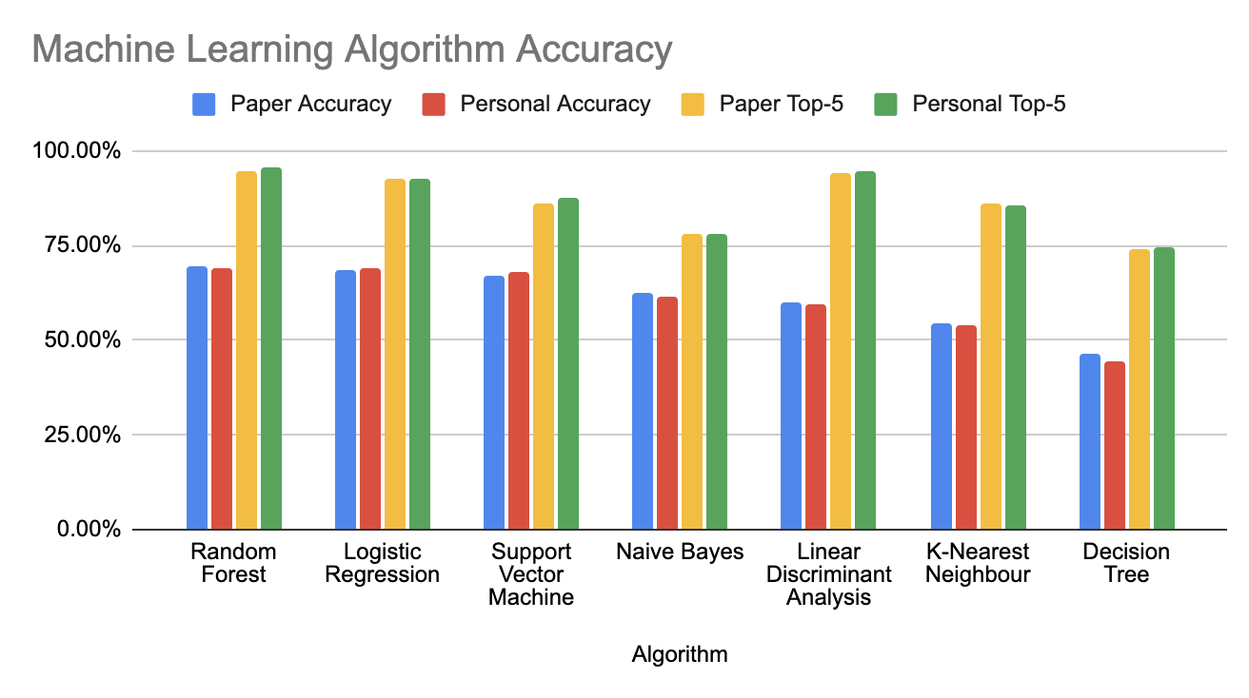
Machine Learning Accuracy Results

Slide 13
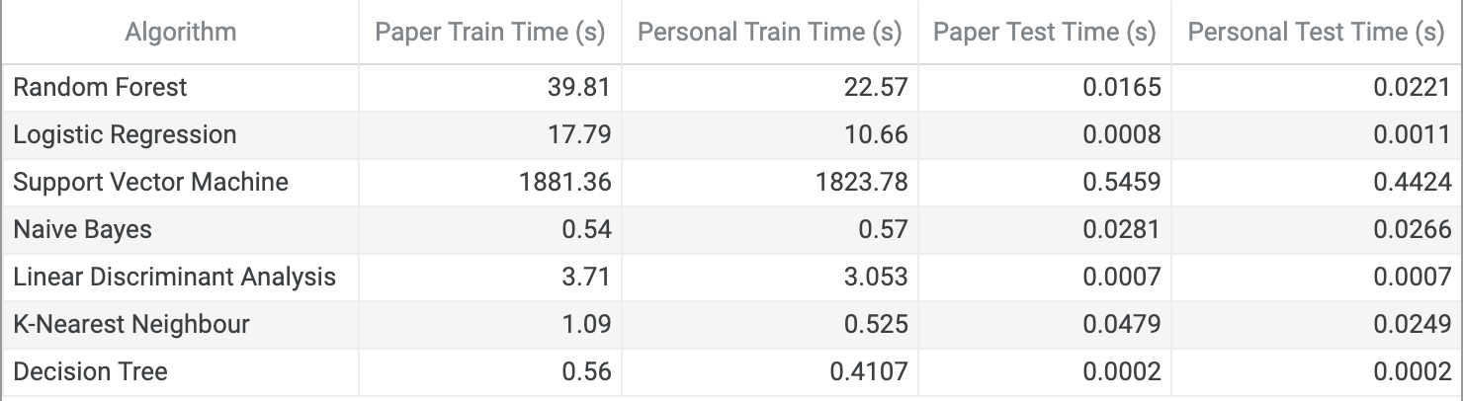
Machine Learning Execution Time Results

Slide 14
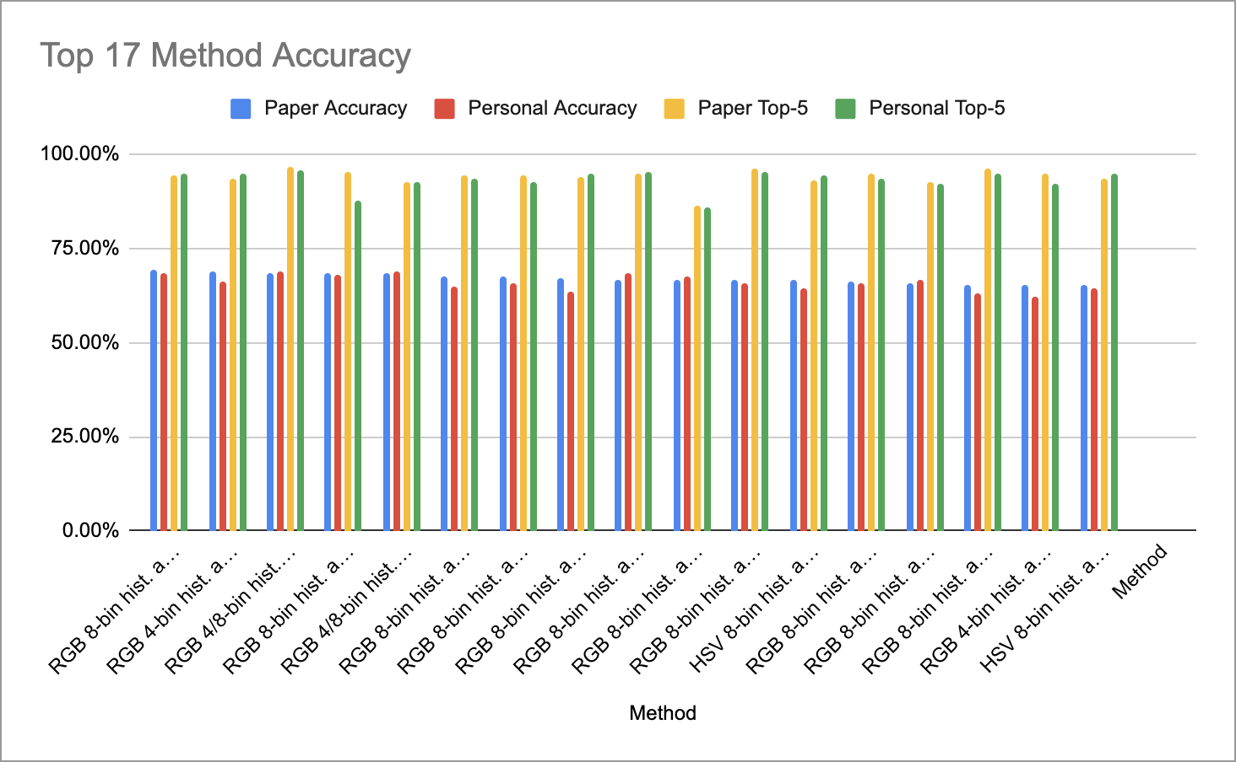
Feature Extraction Method Results Accuracy

Slide 15
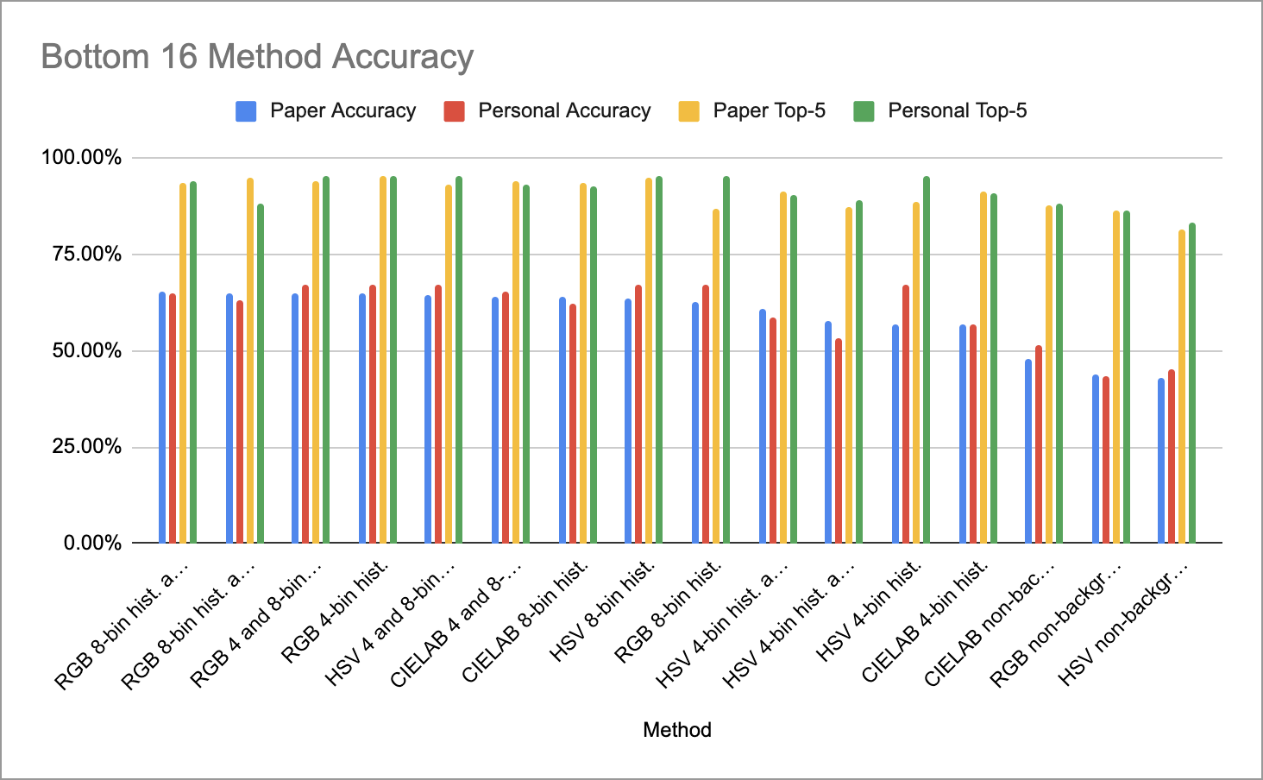
Feature Extraction Method Results Accuracy

Slide 16
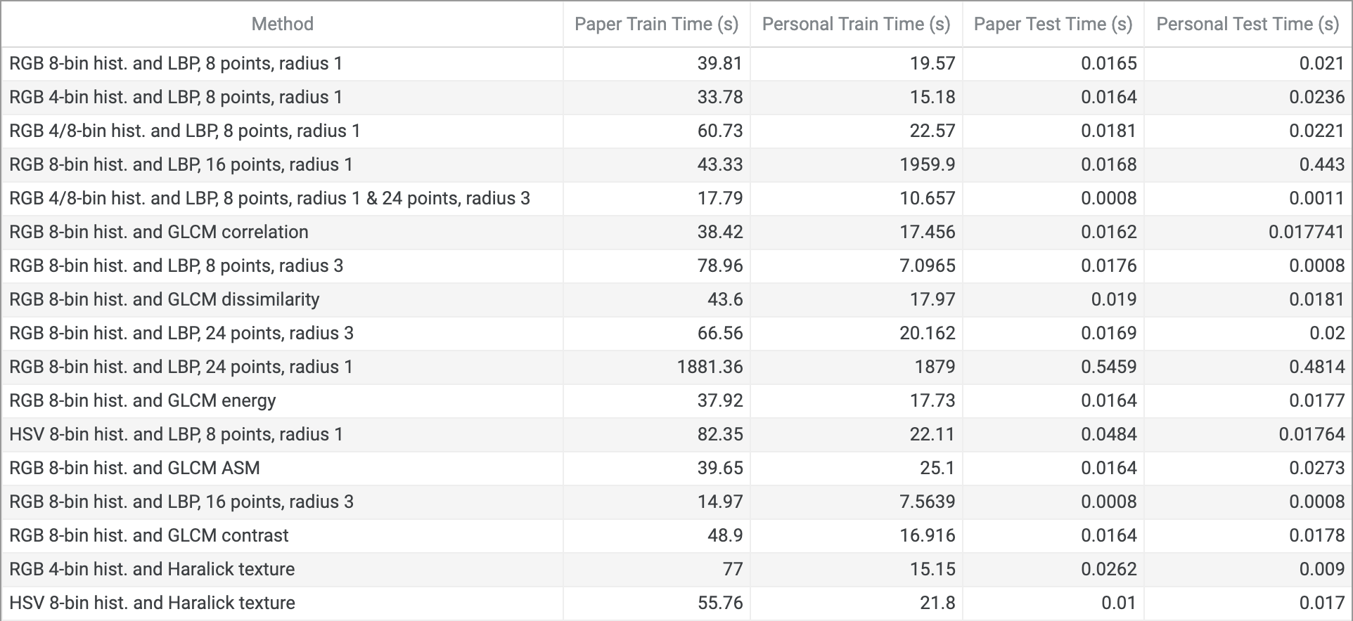
Feature Extraction Method Results Execution Time

Slide 17
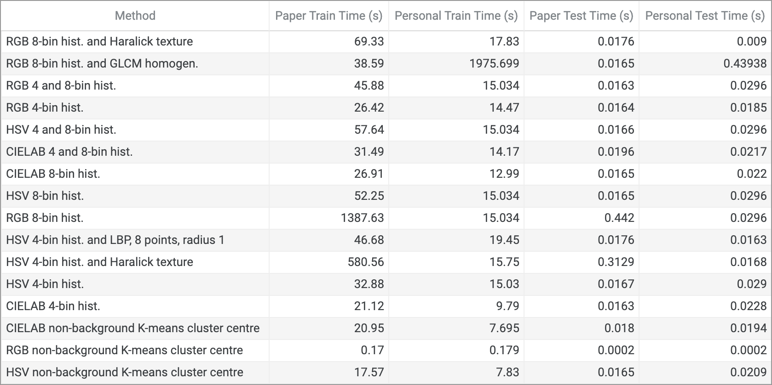
Feature Extraction Method Results Execution Time

Slide 18
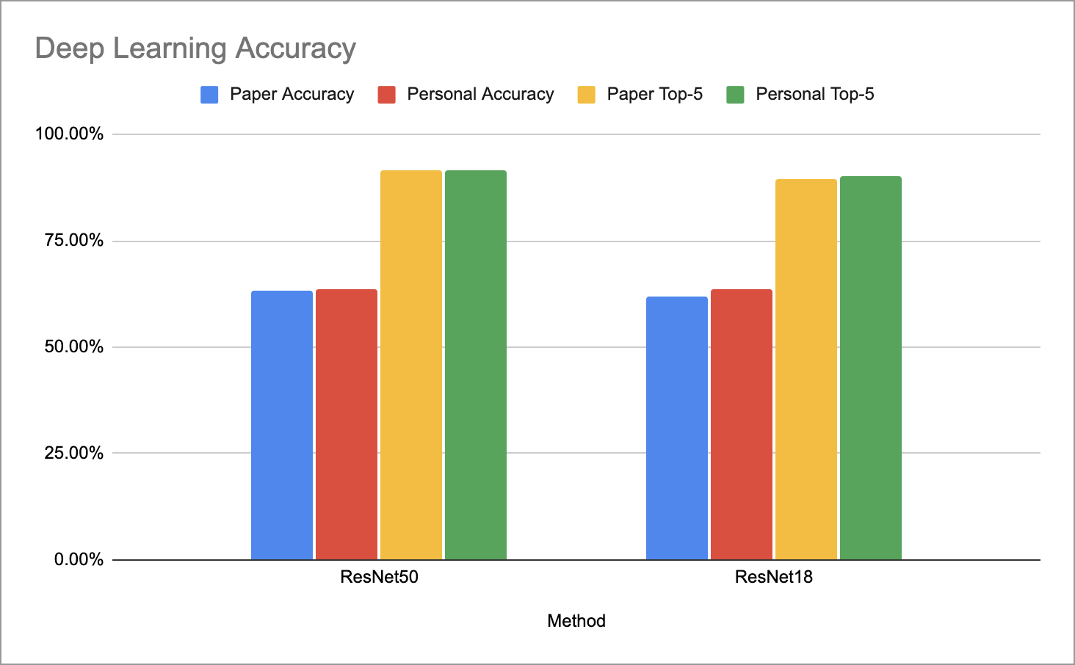
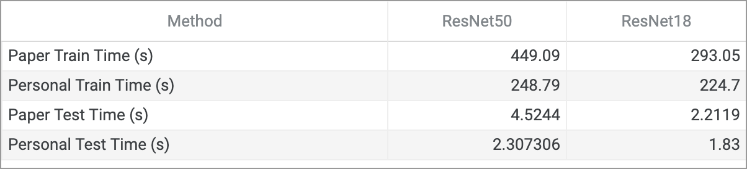
Deep Learning Results
Paper: Google Colab NVIDIA Tesla K80 GPU
Personal: Google Colab NVIDIA Tesla T4 GPU

Slide 19
Next Steps
Added Data
Total 85 Classes
2796 Training Images
355 Test Images
Tested against ResNext network
Ideas to go further
Manual Segmentation
Exploring other Textural Features
Adjusting Machine Learning Parameters
Seeking out additional data

Slide 20
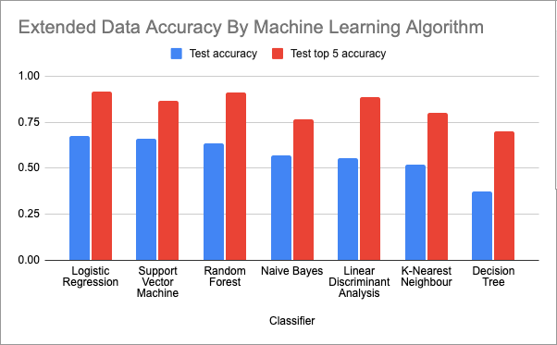
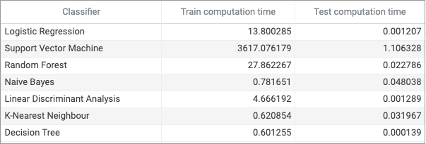
Machine Learning Results Against Expanded Data

Slide 21
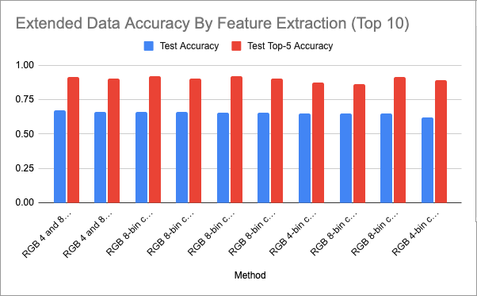
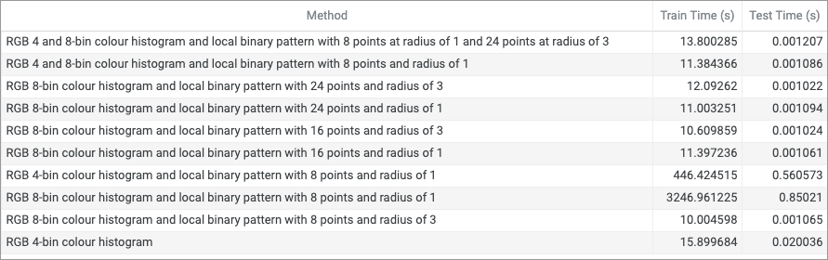
Feature Extraction Method Results Extended Data
(Top 10)

Slide 22
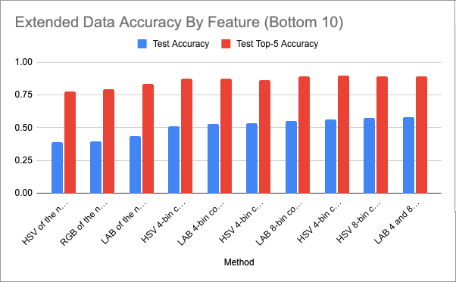
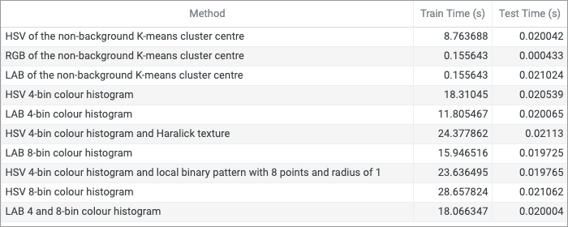
Feature Extraction Method Results Extended Data
(Bottom 10)

Slide 23
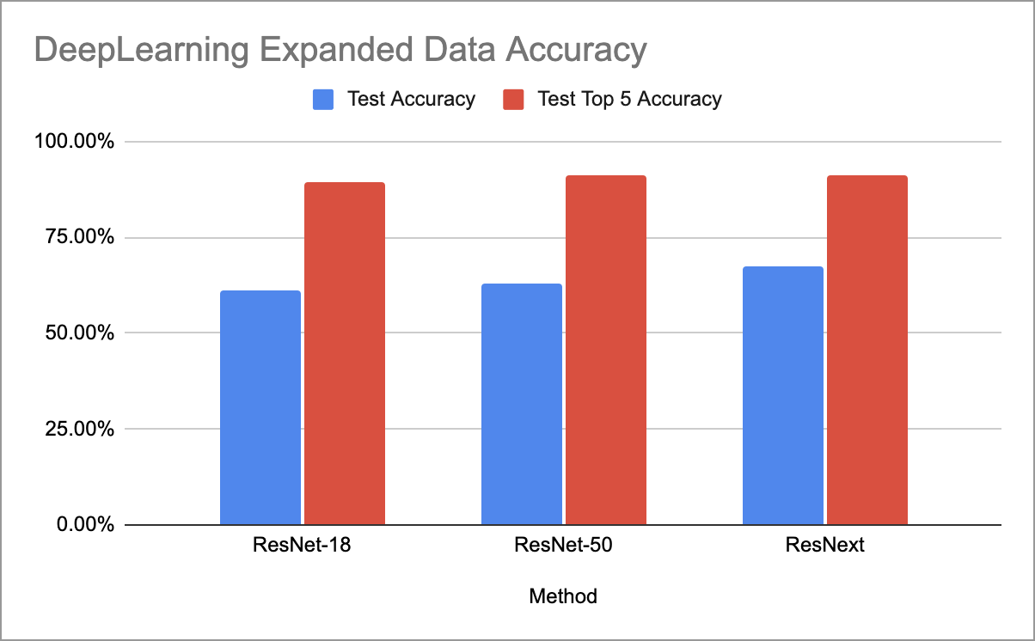
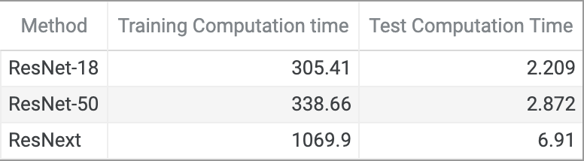
Deep Learning Results Against Expanded Data

Slide 24
Resources
Paper
https://www.mdpi.com/2075-163X/12/1/60
Code
https://github.com/hybchow/gems
Dataset
https://www.kaggle.com/datasets/lsind18/gemstones-images
Presentation
https://en.wikipedia.org/wiki/CIELAB_color_space
https://en.wikipedia.org/wiki/Local_binary_patterns
https://www.researchgate.net/figure/An-illustration-of-how-the-Haralick-texture-features-are-computed-In-a-4-4-image_fig1_331289061

Slide 25
Questions?

Slide 26
Machine Learning Algorithm Results
Algorithm | Paper Accuracy | Personal Accuracy | Paper Top-5 | Personal Top-5 | Paper Train Time (s) | Personal Train Time (s) | Paper Test Time (s) | Personal Test Time (s)
Random Forest | 69.4% | 69.01% | 94.4% | 95.77% | 39.81 | 22.57 | 0.0165 | 0.0221
Logistic Regression | 68.7% | 69.01% | 92.6% | 92.6% | 17.79 | 10.66 | 0.0008 | 0.0011
Support Vector Machine | 66.9% | 67.96% | 86.3% | 87.67% | 1881.36 | 1823.78 | 0.5459 | 0.4424
Naive Bayes | 62.7% | 61.27% | 77.8% | 78.17% | 0.54 | 0.57 | 0.0281 | 0.0266
Linear Discriminant Analysis | 59.9% | 59.5% | 94.0% | 94.37% | 3.71 | 3.053 | 0.0007 | 0.0007
K-Nearest Neighbour | 54.6% | 53.87% | 85.9% | 85.6% | 1.09 | 0.525 | 0.0479 | 0.0249
Decision Tree | 46.5% | 44.4% | 73.9% | 74.3% | 0.56 | 0.4107 | 0.0002 | 0.0002

Slide 27
Feature Extraction Results
Method | Paper Accuracy | Personal Accuracy | Paper Top-5 | Personal Top-5 | Paper Train Time (s) | Personal Train Time (s) | Paper Test Time (s) | Personal Test Time (s)
RGB 8-bin hist. and LBP, 8 points, radius 1 | 69.4% | 68.3% | 94.4% | 95.07% | 39.81 | 19.57 | 0.0165 | 0.0210
RGB 4-bin hist. and LBP, 8 points, radius 1 | 69.0% | 66.2% | 93.7% | 94.7% | 33.78 | 15.18 | 0.0164 | 0.0236
RGB 4/8-bin hist. and LBP, 8 points, radius 1 | 68.7% | 69.01% | 96.5% | 95.77 | 60.73 | 22.57 | 0.0181 | 0.0221
RGB 8-bin hist. and LBP, 16 points, radius 1 | 68.7% | 67.9% | 95.4% | 87.7% | 43.33 | 1959.9 | 0.0168 | 0.443
RGB 4/8-bin hist. and LBP, 8 points, radius 1 & 24 points, radius 3 | 68.7% | 69.0% | 92.6% | 92.6% | 17.79 | 10.657 | 0.0008 | 0.0011
RGB 8-bin hist. and GLCM correlation | 67.6% | 65.1% | 94.4% | 93.6% | 38.42 | 17.456 | 0.0162 | 0.017741
RGB 8-bin hist. and LBP, 8 points, radius 3 | 67.6% | 65.8% | 94.4% | 92.6% | 78.96 | 7.0965 | 0.0176 | 0.0008
RGB 8-bin hist. and GLCM dissimilarity | 67.3% | 63.7% | 94.0% | 95.1% | 43.60 | 17.97 | 0.0190 | 0.0181
RGB 8-bin hist. and LBP, 24 points, radius 3 | 66.9% | 68.6% | 94.7% | 95.4% | 66.56 | 20.162 | 0.0169 | 0.0200

Slide 28
Feature Extraction Results (cont.)
Method | Paper Accuracy | Personal Accuracy | Paper Top-5 | Personal Top-5 | Paper Train Time (s) | Personal Train Time (s) | Paper Test Time (s) | Personal Test Time (s)
RGB 8-bin hist. and LBP, 24 points, radius 1 | 66.9% | 67.6% | 86.3% | 85.9% | 1881.36 | 1879 | 0.5459 | 0.4814
RGB 8-bin hist. and GLCM energy | 66.5% | 65.8% | 96.1% | 95.4% | 37.92 | 17.73 | 0.0164 | 0.0177
HSV 8-bin hist. and LBP, 8 points, radius 1 | 66.5% | 64.4% | 93.3% | 94.4% | 82.35 | 22.11 | 0.0484 | 0.01764
RGB 8-bin hist. and GLCM ASM | 66.2% | 65.8% | 94.7% | 93.67% | 39.65 | 25.100 | 0.0164 | 0.0273
RGB 8-bin hist. and LBP, 16 points, radius 3 | 65.8% | 66.5% | 92.6% | 92.25% | 14.97 | 7.5639 | 0.0008 | 0.0008
RGB 8-bin hist. and GLCM contrast | 65.5% | 63.0% | 96.1% | 95.07% | 48.90 | 16.916 | 0.0164 | 0.0178
RGB 4-bin hist. and Haralick texture | 65.5% | 62.3% | 95.1% | 92.2% | 77.00 | 15.15 | 0.0262 | 0.009
HSV 8-bin hist. and Haralick texture | 65.5% | 64.4% | 93.7% | 94.7% | 55.76 | 21.8 | 0.0100 | 0.017
RGB 8-bin hist. and Haralick texture | 65.5% | 64.7% | 93.7% | 94.0% | 69.33 | 17.83 | 0.0176 | 0.009

Slide 29
Feature Extraction Results (cont.)
Method | Paper Accuracy | Personal Accuracy | Paper Top-5 | Personal Top-5 | Paper Train Time (s) | Personal Train Time (s) | Paper Test Time (s) | Personal Test Time (s)
RGB 8-bin hist. and GLCM homogen. | 65.1% | 63.3% | 95.1% | 88.02% | 38.59 | 1975.699 | 0.0165 | 0.43938
RGB 4 and 8-bin hist. | 65.1% | 67.25% | 94.0% | 95.4% | 45.88 | 15.034 | 0.0163 | 0.0296
RGB 4-bin hist. | 64.8% | 67.25% | 95.4% | 95.4% | 26.42 | 14.47 | 0.0164 | 0.0185
HSV 4 and 8-bin hist. | 64.4% | 67.25% | 93.3% | 95.4% | 57.64 | 15.034 | 0.0166 | 0.0296
CIELAB 4 and 8-bin hist. | 64.1% | 65.5% | 94.0% | 93.3% | 31.49 | 14.17 | 0.0196 | 0.0217
CIELAB 8-bin hist. | 64.1% | 62.3% | 93.7% | 92.6% | 26.91 | 12.99 | 0.0165 | 0.022
HSV 8-bin hist. | 63.4% | 67.25% | 95.1% | 95.4% | 52.25 | 15.034 | 0.0165 | 0.0296
ResNet50 | 63.4% | 63.7% | 91.5% | 91.5% | 449.09 | 248.79 | 4.5244 | 2.307306
RGB 8-bin hist. | 62.7% | 67.25% | 87.0% | 95.4% | 1387.63 | 15.034 | 0.4420 | 0.0296
ResNet18 | 62.0% | 63.7% | 89.4% | 90.1% | 293.05 | 224.7 | 2.2119 | 1.83

Slide 30
Feature Extraction Results (cont.)
Method | Paper Accuracy | Personal Accuracy | Paper Top-5 | Personal Top-5 | Paper Train Time (s) | Personal Train Time (s) | Paper Test Time (s) | Personal Test Time (s)
HSV 4-bin hist. and LBP, 8 points, radius 1 | 60.9% | 58.8% | 91.2% | 90.5% | 46.68 | 19.45 | 0.0176 | 0.0163
HSV 4-bin hist. and Haralick texture | 57.7% | 53.2% | 87.3% | 89.1% | 580.56 | 15.75 | 0.3129 | 0.0168
HSV 4-bin hist. | 57.0% | 67.25% | 88.7% | 95.42% | 32.88 | 15.03 | 0.0167 | 0.029
CIELAB 4-bin hist. | 56.7% | 57.0% | 91.5% | 90.8% | 21.12 | 9.79 | 0.0163 | 0.0228
CIELAB non-background K-means cluster centre | 47.9% | 51.7% | 87.7% | 88.0% | 20.95 | 7.695 | 0.0180 | 0.0194
RGB non-background K-means cluster centre | 44.0% | 43.3% | 86.3% | 86.3% | 0.17 | 0.179 | 0.0002 | 0.0002
HSV non-background K-means cluster centre | 43.0% | 45.4% | 81.3% | 83.4% | 17.57 | 7.83 | 0.0165 | 0.0209

Slide 31
Deep Learning Expanded Data Results
Method | Test Accuracy | Test Top 5 Accuracy | Training Computation time (s) | Test Computation Time (s)
ResNet-18 | 61.12% | 89.29% | 305.41 | 2.209
ResNet-50 | 63.09% | 90.98% | 338.66 | 2.872
ResNext | 67.60% | 90.98% | 1069.9 | 6.91

Slide 32
Machine Learning Results Against Expanded Data
Classifier | Test accuracy | Test top 5 accuracy | Train computation time | Test computation time
Logistic Regression | 0.673239 | 0.915493 | 13.800285 | 0.001207
Support Vector Machine | 0.659155 | 0.867606 | 3617.076179 | 1.106328
Random Forest | 0.63662 | 0.909859 | 27.862267 | 0.022786
Naive Bayes | 0.571831 | 0.76338 | 0.781651 | 0.048038
Linear Discriminant Analysis | 0.55493 | 0.884507 | 4.666192 | 0.001289
K-Nearest Neighbour | 0.521127 | 0.802817 | 0.620854 | 0.031967
Decision Tree | 0.374648 | 0.701408 | 0.601255 | 0.000139

Slide 33
Feature Extraction Results Against Expanded Data (Top 10)
Method | Test Accuracy | Test Top-5 Accuracy | Train Time (s) | Test Time (s)
RGB 4 and 8-bin colour histogram and local binary pattern with 8 points at radius of 1 and 24 points at radius of 3 | 0.673239 | 0.915493 | 13.800285 | 0.001207
RGB 4 and 8-bin colour histogram and local binary pattern with 8 points and radius of 1 | 0.661972 | 0.904225 | 11.384366 | 0.001086
RGB 8-bin colour histogram and local binary pattern with 24 points and radius of 3 | 0.661972 | 0.921127 | 12.09262 | 0.001022
RGB 8-bin colour histogram and local binary pattern with 24 points and radius of 1 | 0.659155 | 0.904225 | 11.003251 | 0.001094
RGB 8-bin colour histogram and local binary pattern with 16 points and radius of 3 | 0.656338 | 0.921127 | 10.609859 | 0.001024
RGB 8-bin colour histogram and local binary pattern with 16 points and radius of 1 | 0.656338 | 0.904225 | 11.397236 | 0.001061
RGB 4-bin colour histogram and local binary pattern with 8 points and radius of 1 | 0.650704 | 0.873239 | 446.424515 | 0.560573
RGB 8-bin colour histogram and local binary pattern with 8 points and radius of 1 | 0.650704 | 0.864789 | 3246.961225 | 0.85021
RGB 8-bin colour histogram and local binary pattern with 8 points and radius of 3 | 0.647887 | 0.915493 | 10.004598 | 0.001065
RGB 4-bin colour histogram | 0.619718 | 0.892958 | 15.899684 | 0.020036

Slide 34
Feature Extraction Results Against Expanded Data (Bottom 10)
Method | Test Accuracy | Test Top-5 Accuracy | Train Time (s) | Test Time (s)
HSV of the non-background K-means cluster centre | 0.388732 | 0.774648 | 8.763688 | 0.020042
RGB of the non-background K-means cluster centre | 0.397183 | 0.791549 | 0.155643 | 0.000433
LAB of the non-background K-means cluster centre | 0.433803 | 0.833803 | 0.155643 | 0.021024
HSV 4-bin colour histogram | 0.512676 | 0.873239 | 18.31045 | 0.020539
LAB 4-bin colour histogram | 0.526761 | 0.876056 | 11.805467 | 0.020065
HSV 4-bin colour histogram and Haralick texture | 0.535211 | 0.861972 | 24.377862 | 0.02113
LAB 8-bin colour histogram | 0.552113 | 0.890141 | 15.946516 | 0.019725
HSV 4-bin colour histogram and local binary pattern with 8 points and radius of 1 | 0.56338 | 0.895775 | 23.636495 | 0.019765
HSV 8-bin colour histogram | 0.577465 | 0.890141 | 28.657824 | 0.021062
LAB 4 and 8-bin colour histogram | 0.580282 | 0.890141 | 18.066347 | 0.020004

